Slide 1
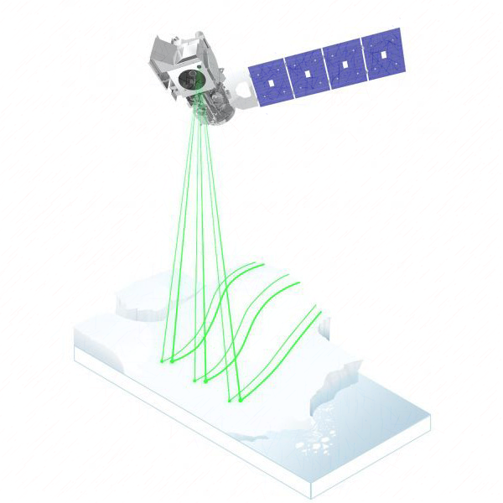

Snow depth retrieval and downscaling using
satellite laser altimetry, machine learning and climate reanalysis
a case study in mainland Norway
Zhihao LIU
2023-06
Supervisor | Andreas Max Kääb, Désirée Treichler
Projects | SNOWDEPTH: Global snow depths from space-borne remote sensing for permafrost, high-elevation precipitation, and climate reanalyzes
Notes:
Hi, my name is Zhihao. In the past of year, I work on the topic:
Snow depth retrieval and downscaling using satellite laser altimetry, machine learning and climate reanalysis

Slide 2
Snow depth retrieval and downscaling using
satellite laser altimetry, machine learning and climate reanalysis
Part 1: Background
Statement of problem
Challenges & Objectives
Study area & Data setting
Part 2: Method ‘CBD’
Co-registration
Bias correction
Downscaling
Part 3: Results and Discussion
Part 4: Conclusion and Outlooks
Outline
Notes:
I will start with the background of the study:
Why the seasonal snow accumulation is important.
Why the current solutions are not good enough?
Next, I will elaborate on my method.
The co-registration and bias correction are the necessary steps for snow depth retrieval.
And the downscaling is how I use my observation and generate final snow depth at hillslope scales.
After that, I will discussion the main findings, have a discussion on my results.

Slide 3
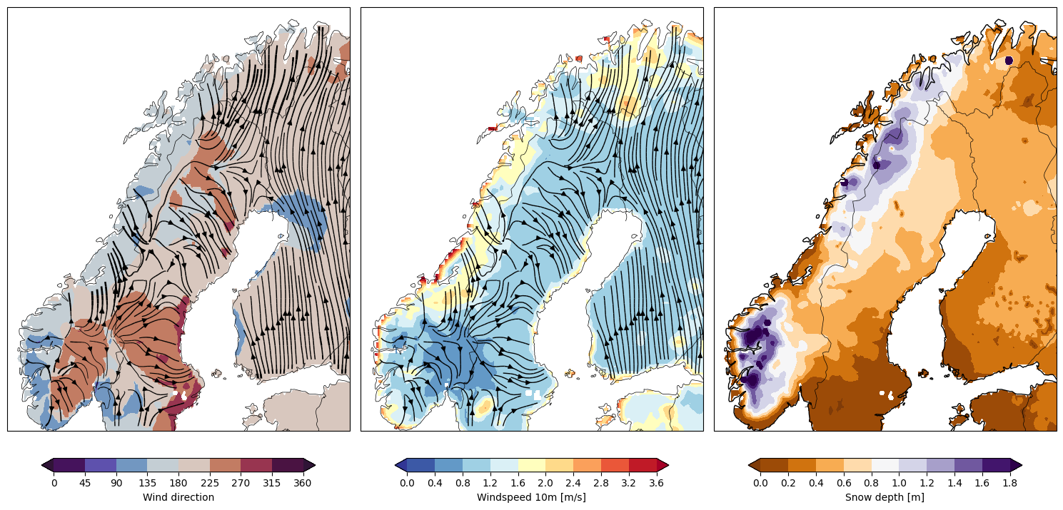
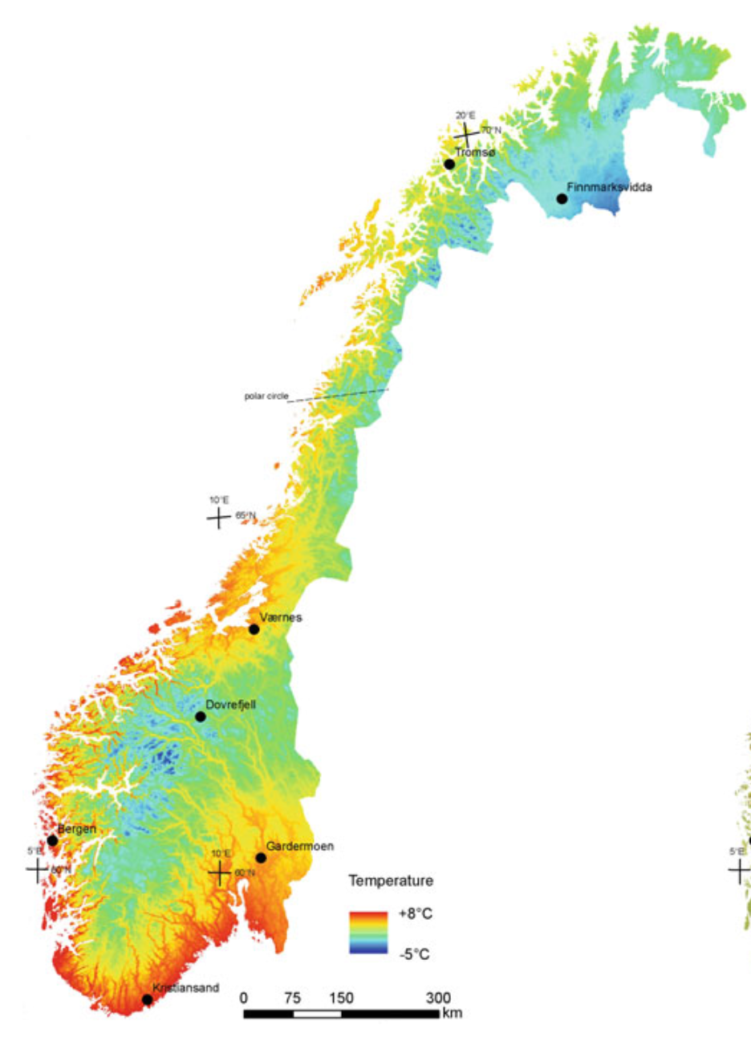
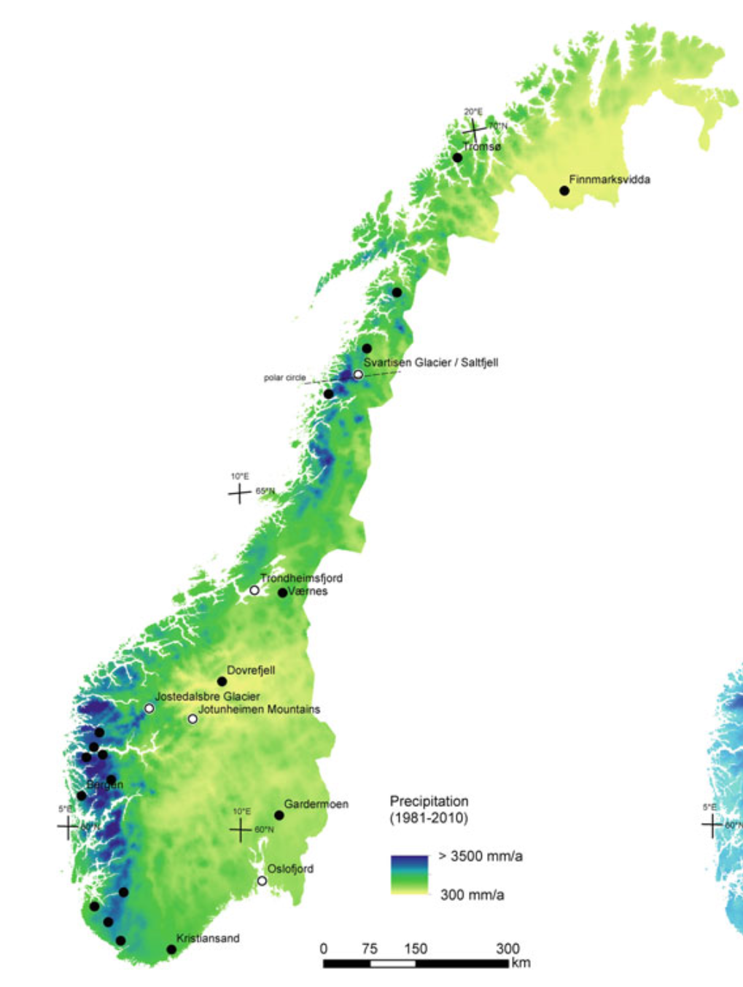
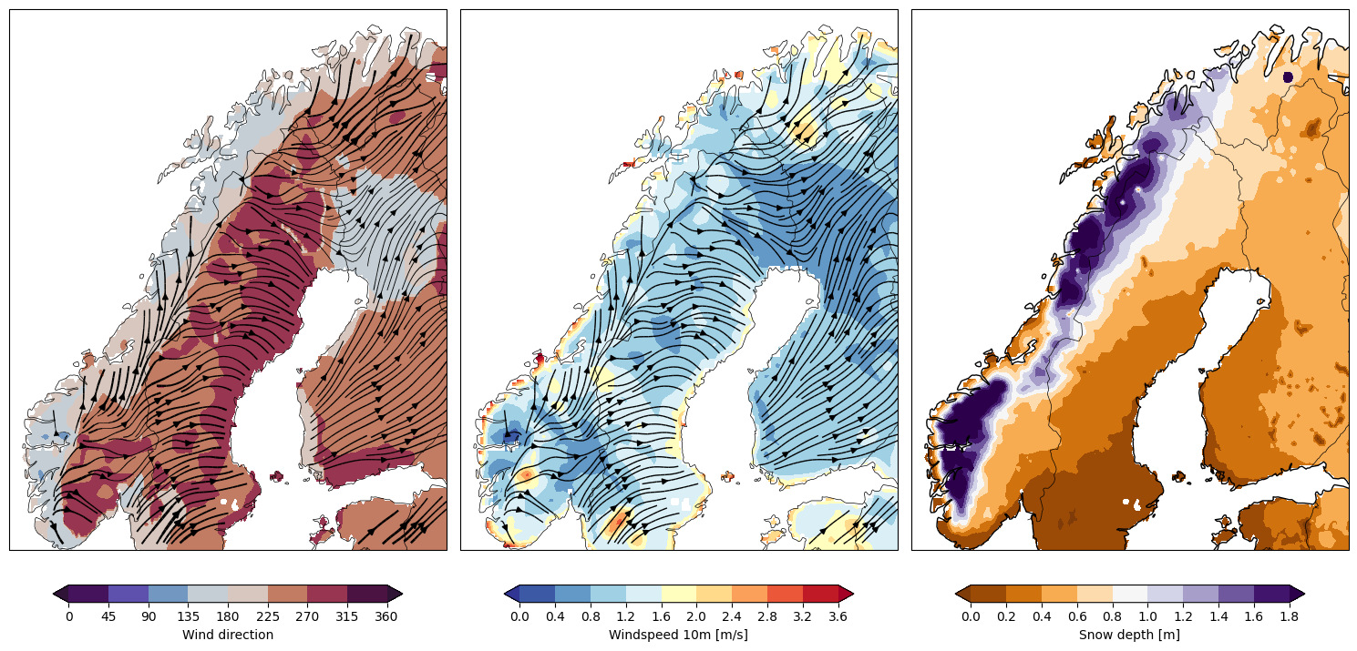
Background | Method ‘CBD’ | Results and Discussion | Conclusion and Outlooks
Study area
Wind
Snow
Mean Temperature
Annual Precipitation
(e) 1961-1990
(f) 1961-1990
(c) Winter 2020-2021
(d) Winter 2021-2022
Notes:
The North Atlantic Current, moderates the range of temperatures throughout the year, particularly along the coastal areas of Norway [@kaspi.schneider_2011; @keil.etal_2020]. During winter, the air temperature is usually lower than the water temperature of the current, resulting in higher evaporation rates [@seppala_2005]. Moist air masses are carried with the westerly winds, leading to heavy precipitation averaging from 1000 to 3000 mm per year in coastal areas when moist air is uplifted by the mountains As, a result, in Scandinavia peninsula, here, Mainland Norway has astonished snow accumulation, particularly in western mountain, where the temperature is relatively low, and more precipitation fall as snow. Seasonal snow plays a crucial role as water reservoirs.

Slide 4
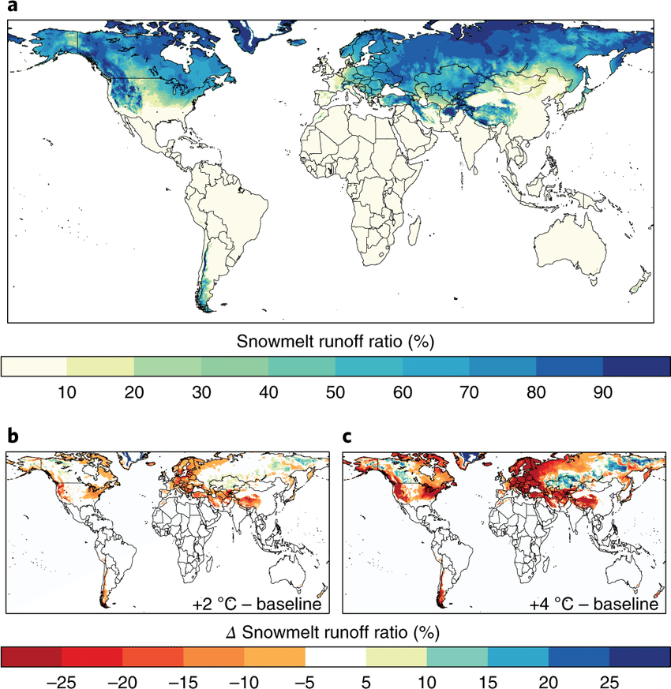
Background | Method ‘CBD’ | Results and Discussion | Conclusion and Outlooks
Statement of problem: Accurately estimating the snow depth remains a challenge.
Seasonal snow plays a crucial role as water reservoirs, particularly for the mountain environment.
However, accurately estimating the snow depth remains a challenge, particularly in the mountain area.
Bormann, K. J., Brown, R. D., Derksen, C., & Painter, T. H. (2018). Estimating snow-cover trends from space. Nature Climate Change, 8(11), 924–928.
Mudryk, L. R., Derksen, C., Kushner, P. J., & Brown, R. (2015). Characterization of Northern Hemisphere Snow Water Equivalent Datasets, 1981–2010. Journal of Climate, 28(20), 8037–8051.
Notes:
For instance, the graph here indicates how much run-off comes from snow melting water. In Norway here, on average, 50% of runoff is from snowmelt, we can call this area snow-melt catchment. Particularly, in this area, the alterations in snowpacks can significantly impact water availability. But accurately estimating the depth of the snowpack remains a challenge.

Slide 5
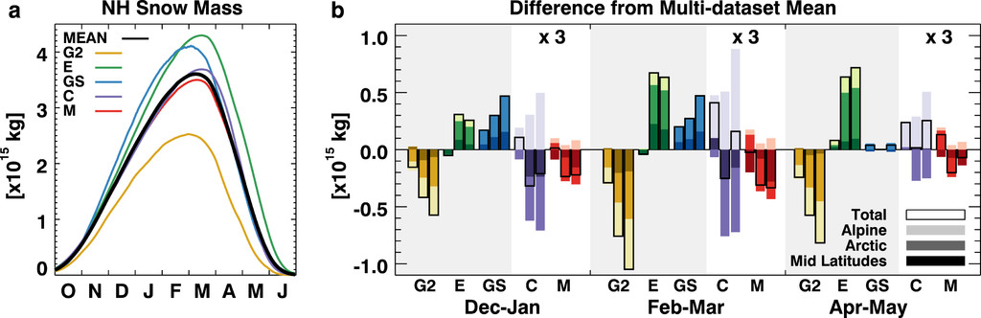
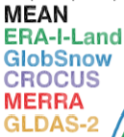

Background | Method ‘CBD’ | Results and Discussion | Conclusion and Outlooks
Statement of problem: Accurately estimating the snow depth remains a challenge.
Seasonal snow plays a crucial role as water reservoirs, particularly for the mountain environment.
However, accurately estimating the snow depth remains a challenge, particularly in the mountain area.
1200 Gt
Global snow mass products vary as much as 50% (Mudryk et al., 2015). Mountainous areas are masked out (Bormann et al., 2018).
1981-2010 period
Bormann, K. J., Brown, R. D., Derksen, C., & Painter, T. H. (2018). Estimating snow-cover trends from space. Nature Climate Change, 8(11), 924–928.
Mudryk, L. R., Derksen, C., Kushner, P. J., & Brown, R. (2015). Characterization of Northern Hemisphere Snow Water Equivalent Datasets, 1981–2010. Journal of Climate, 28(20), 8037–8051.
Notes:
Seasonal snow plays a crucial role as water reservoirs and energy balance component. For instance, the graph here indicates how much run-off comes from snow melting water. In Norway here, on average, 50% of runoff is from snowmelt, we can call this area snow-melt catchment. Particularly, in this area, the alterations in snowpacks can significantly impact water availability. But accurately estimating the depth of the snowpack remains a challenge.
The global snow mass products presented here have huge differences, ranging up to 50% to each other.
At the local scale, snow has a complex spatial variability. Most of the products are not able to describe the subgrid distribution of snow depth. Because it is related to complicated physical process such as wind-redistribution and snow-vegetation interactions. It requires much more high-resolution snow depth observations.
But weather stations are generally located in gentle terrain, which makes it difficult to represent the snow depth with varying topography.

Slide 6
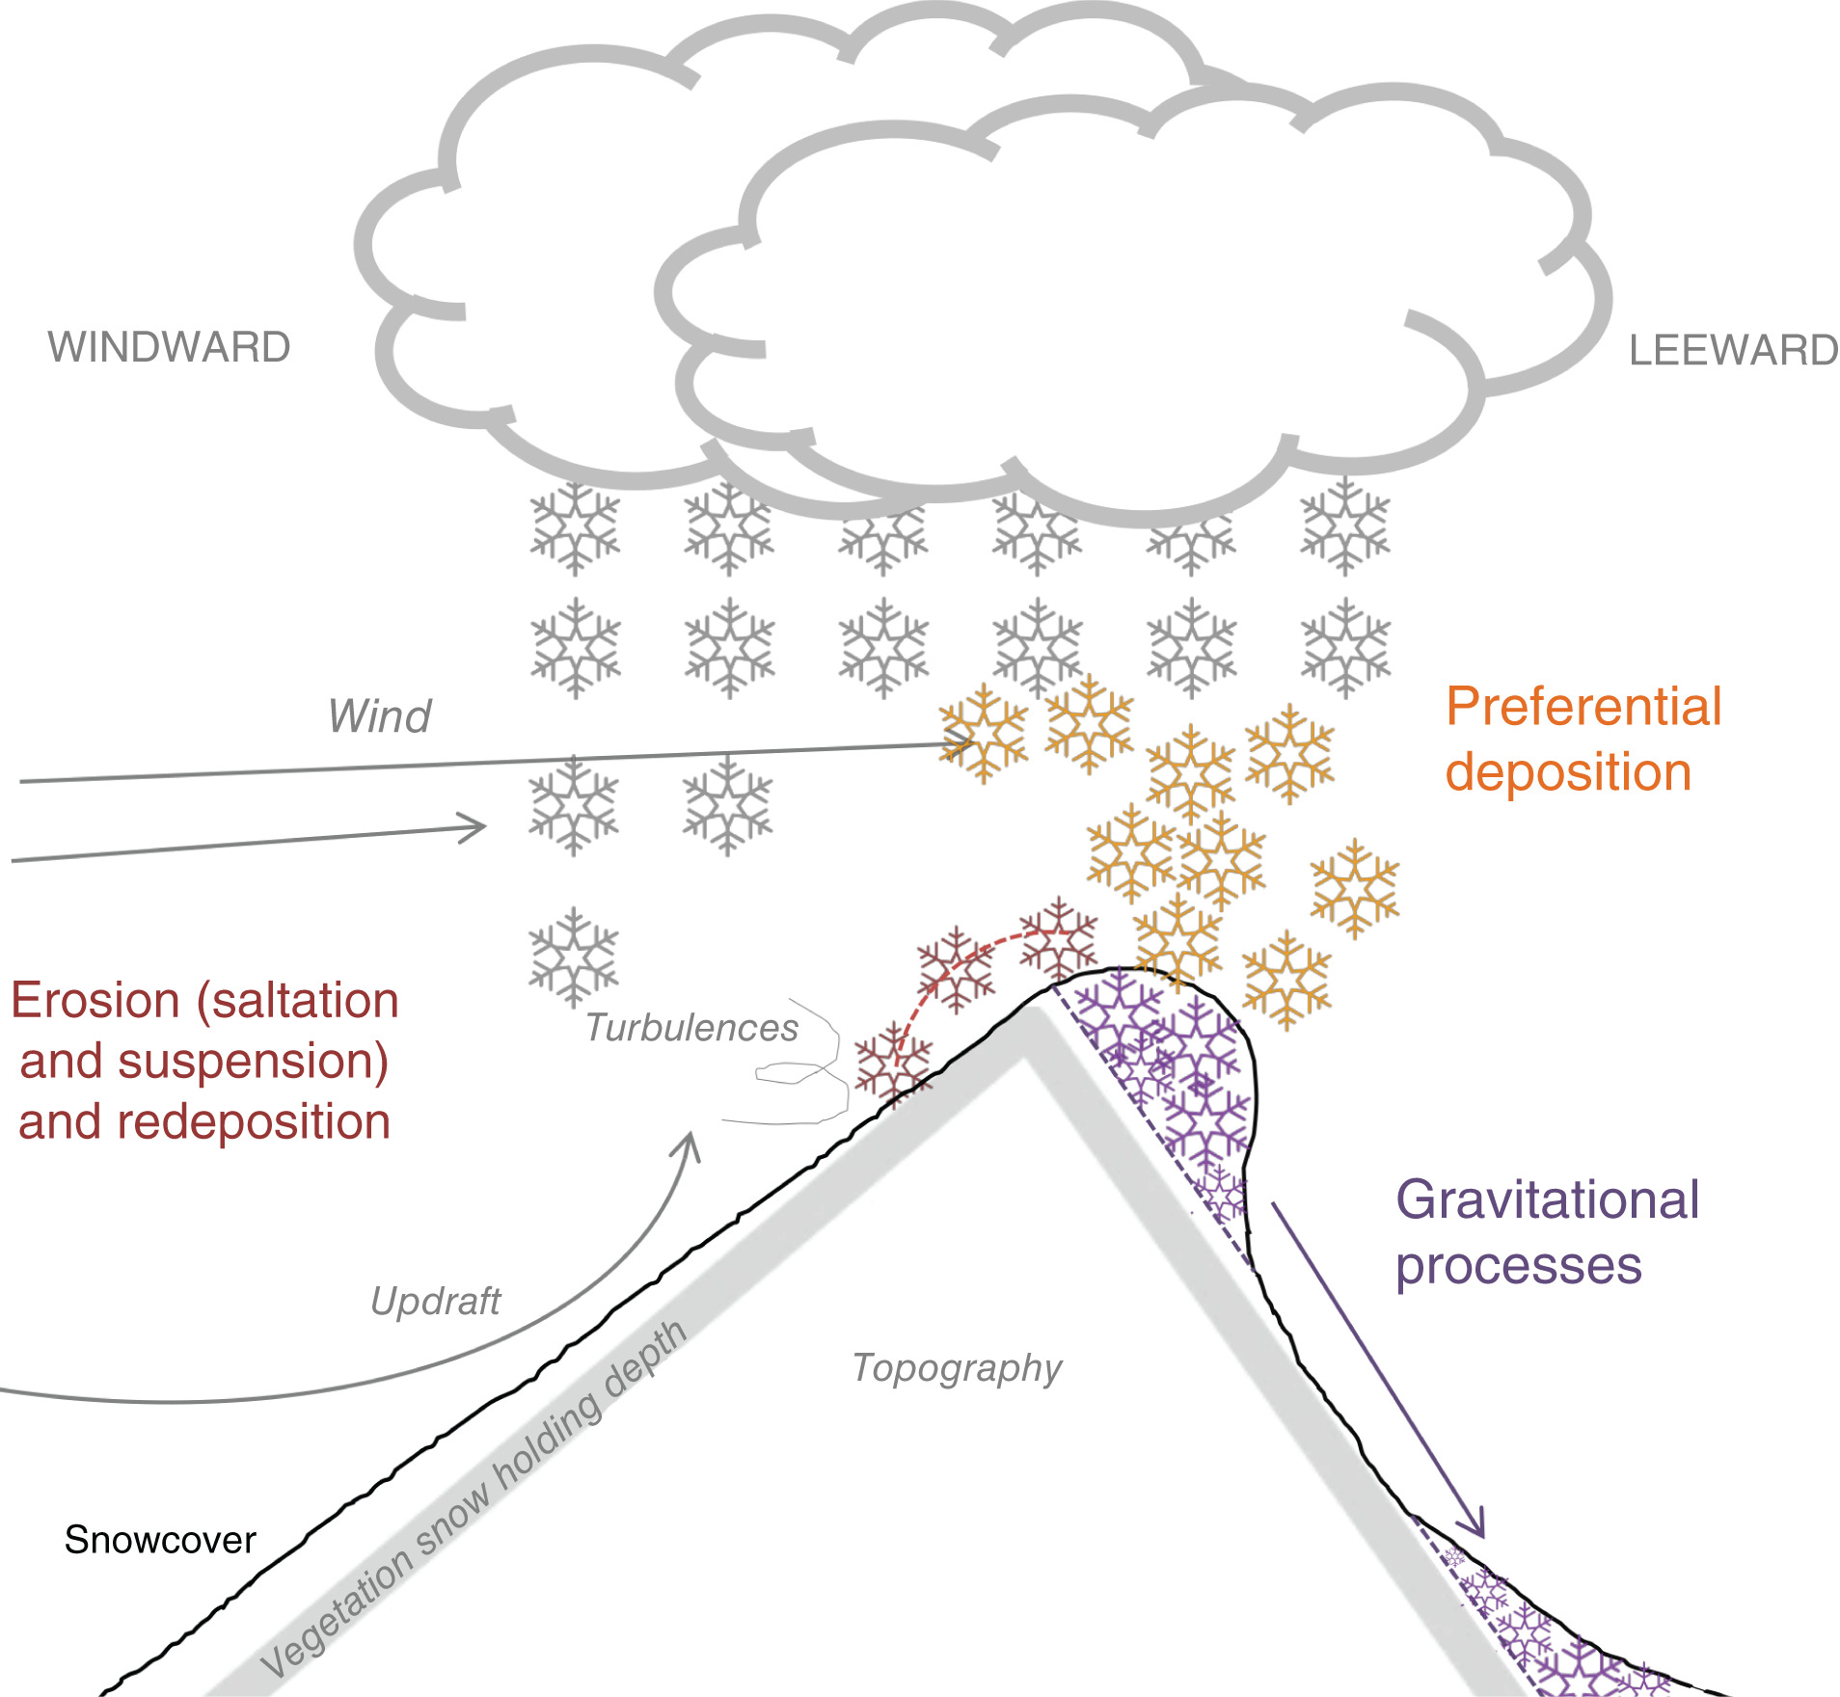
Background | Method ‘CBD’ | Results and Discussion | Conclusion and Outlooks
Statement of problem: Accurately estimating the snow depth remains a challenge.
Seasonal snow plays a crucial role as water reservoirs, particularly for the mountain environment.
However, accurately estimating the snow depth remains a challenge, particularly in the mountain area.
1200 Gt
Global snow mass products vary as much as 50% (Mudryk et al., 2015). Mountainous areas are masked out (Bormann et al., 2018).
In mountain environment, snow has a complex spatial variability due to wind redistribution, vegetation… (Sub-grid distribution problem)
1981-2010 period
Bormann, K. J., Brown, R. D., Derksen, C., & Painter, T. H. (2018). Estimating snow-cover trends from space. Nature Climate Change, 8(11), 924–928.
Mudryk, L. R., Derksen, C., Kushner, P. J., & Brown, R. (2015). Characterization of Northern Hemisphere Snow Water Equivalent Datasets, 1981–2010. Journal of Climate, 28(20), 8037–8051.
Notes:
Seasonal snow plays a crucial role as water reservoirs and energy balance component. For instance, the graph here indicates how much run-off comes from snow melting water. In Norway here, on average, 50% of runoff is from snowmelt, we can call this area snow-melt catchment. Particularly, in this area, the alterations in snowpacks can significantly impact water availability. But accurately estimating the depth of the snowpack remains a challenge.
The global snow mass products presented here have huge differences, ranging up to 50% to each other.
At the local scale, snow has a complex spatial variability. Most of the products are not able to describe the subgrid distribution of snow depth. Because it is related to complicated physical process such as wind-redistribution and snow-vegetation interactions. It requires much more high-resolution snow depth observations.
But weather stations are generally located in gentle terrain, which makes it difficult to represent the snow depth with varying topography.

Slide 7
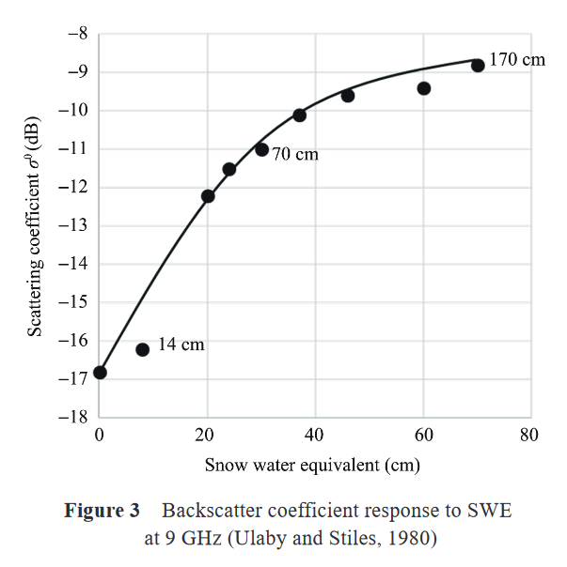
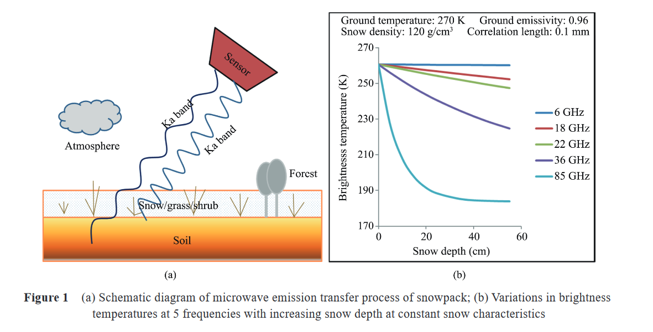



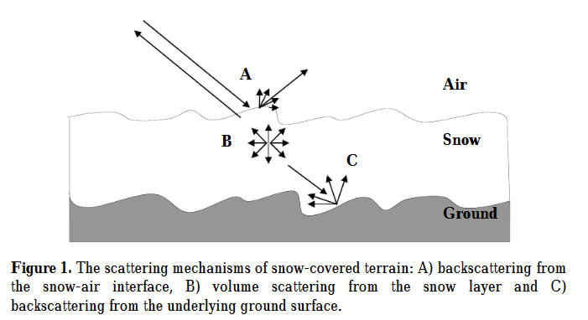
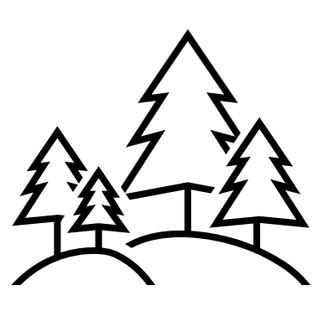

Background | Method ‘CBD’ | Results and Discussion | Conclusion and Outlooks
Statement of problem: Accurately estimating the snow depth remains a challenge.
(a)
Passive radiometer
(b)
Radar scatering
(c)
Elevation differencing
19 GHz
37 GHz
Vegetation Interference
Liquid water
interference
Notes:
Why we know so few about snow depth in mountain environments? This is the remote sensing techniques for snow depth today.
The passive microwave radiometers have been used since 1978, it used the brightness temperature differences at 19 and 37 GHz channels to calculate the snow depth. The resolution ranges from 25km to 50km, this method does not work in mountain terrain, and does not work for dense vegetated area because of interference. Moreover, the presence of liquid water also significantly increases microwave absorption.
The active radar scattering singles can also be used to retrieve snow depth. The backscattering signals are from air-snow interface, within snowpack, and snow-ground interface, in which only the signals from snowpack is useful. If there is an ice layer, the signal A will be interference. The liquid water content is also the problem, so this does not work for wet snow. This method has been optimized to estimate dry snow depth at resolution 500 m.
The last commonly used solution is elevation differencing. Surveying the surface twice and calculate the difference. This can provide high resolution snow depth. The airborne lidar is local interest and costly. But, with the advent of laser altimetry, it is possible to address the snow depth at the hillslope scale.

Slide 8
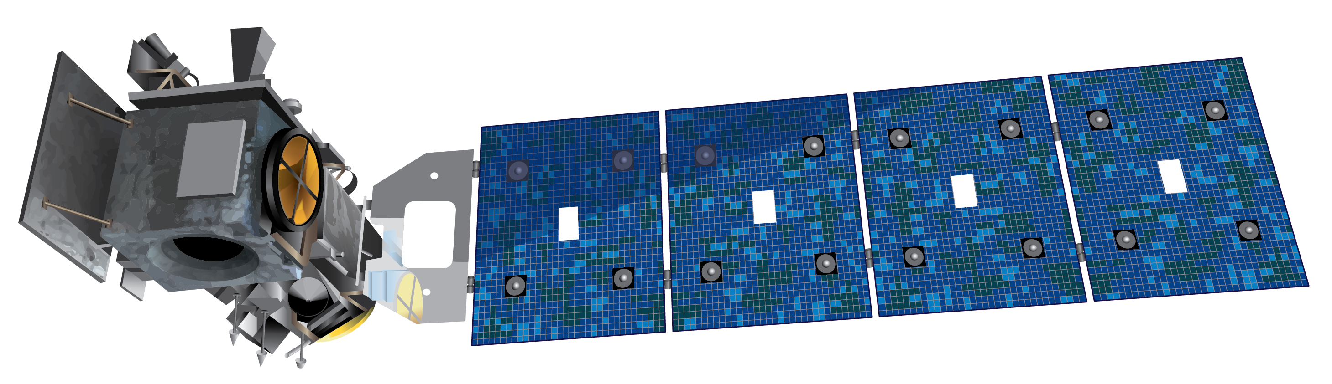
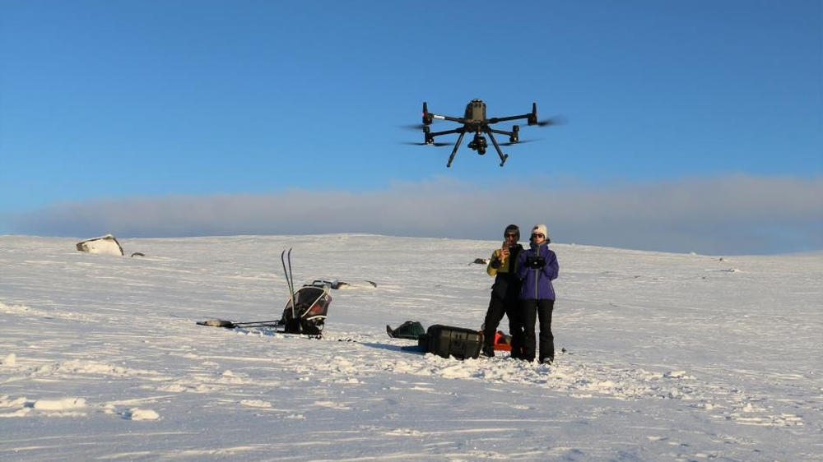
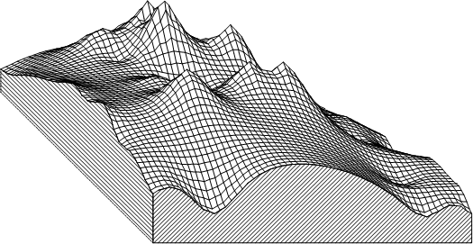
Background | Method ‘CBD’ | Results and Discussion | Conclusion and Outlooks
Challenges & Objectives
(1) ICESat-2 – Snow-on measurements
Challenges of elevation differencing:
DEM’s uncertainties
Co-registration
Bias correction
Satellite's acquisition pattern is sparse in both time and space
Downscaling
Validation
(2) Field trip - validation
‘Method CBD’
Hardangervidda, Southern Norway Photo: Eivind Torgersen
(3) Snow-free DEM
Notes:
So, following with the idea of elevation differencing, what kind of challenges are expected to get snow depth?
First, this method requires snow-free DEMs. And the magnitude of seasonal snow surface elevation change is relatively small compared to the uncertainties associated with DEMs.
Hence, we need to carefully co-registration two datasets.
Moreover, biases are widely present in DEMs. It calls the need for strict quality control and bias correction. Otherwise, we only get noise instead of snow depth.
The snow-on measurements are sparse both in time and space, raising the need for additional steps to produce a spatially complete snow-depth map. This study aims to solve it by downscaling techniques.
Moreover, the results need to be validated, so I joined the field trip and I also get snow depth from NVE.
So the objective of this study is to develop a workflow to address these challenges and applying it using the recently 4 years data from ICESat-2 in Mainland Norway. And also validated by in situ datasets.

Slide 9
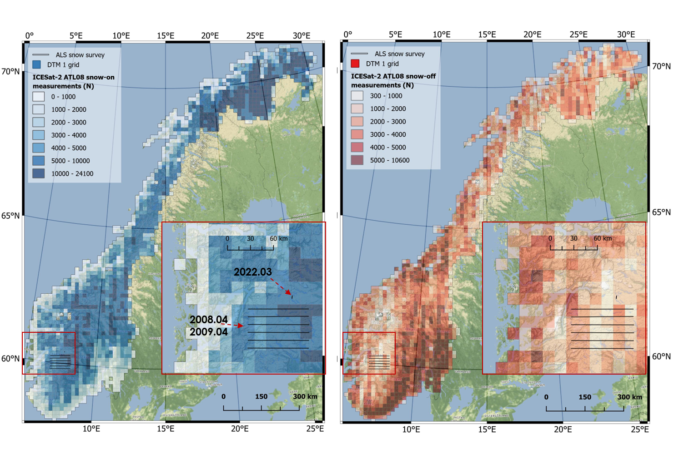
Background | Method ‘CBD’ | Results and Discussion | Conclusion and Outlooks
Data setting
(1) ICESat-2 ATL08 from 2018.10 to 2022.10. 5,443,945 snow-free segments, excluding moving terrain (permanent ice and inland water), and 9,213,030 segments are covered with snow cover.
(2) Four DEMs were used as reference grounds for the entire mainland of Norway:
DTM1, DTM10, Copernicus GLO-30, and FABDEM (Forest And Buildings removed Copernicus DEM, FAB)
(3) ERA5 Land daily snow depth and monthly snow depth
(4) Two validation datasets

Slide 10
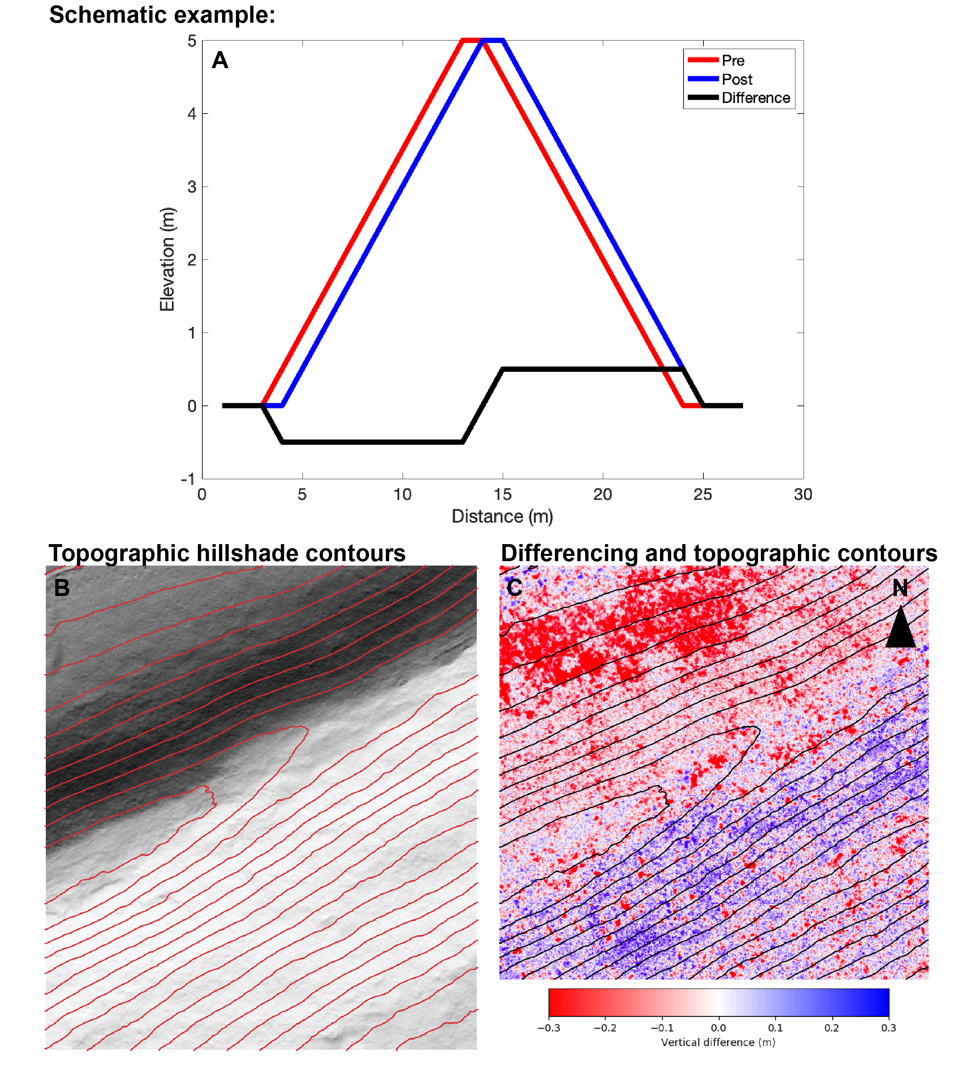
Method ‘CBD’| Results and Discussion | Conclusion and Outlooks
Co-registration: the step to produce the real differences
In elevation differencing workflow, co-registration of snow on and snow-free datasets is the first and critical step.
Image from https://opentopography.org/blog/interpreting-errors-topographic-differencing-results
Nuth, C., & Kääb, A. (2011). Co-registration and bias corrections of satellite elevation data sets for quantifying glacier thickness change. The Cryosphere, 5(1), 271–290. https://doi.org/10.5194/tc-5-271-2011
Notes:
When a DEM is not in perfect geo-referencing, for example, here, the DEM should be in blue, but in red. The misalignment is going to make a difference related to aspect, slope, and the how much it shifts.
In our elevation differencing workflow, the co-registration of snow on and snow-free dataset datasets is the first and critical step.

Slide 11
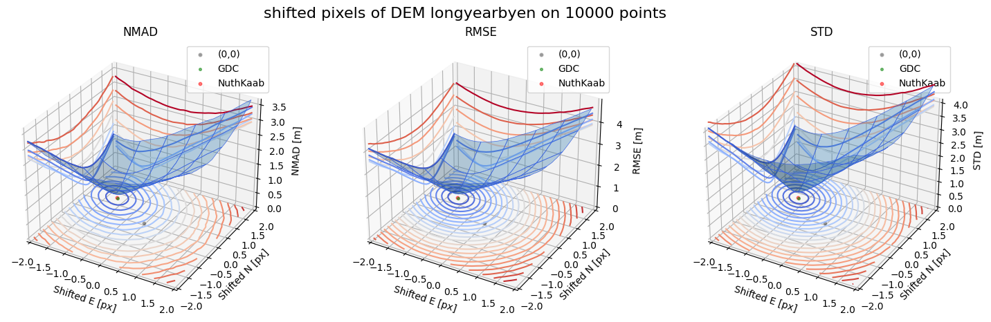
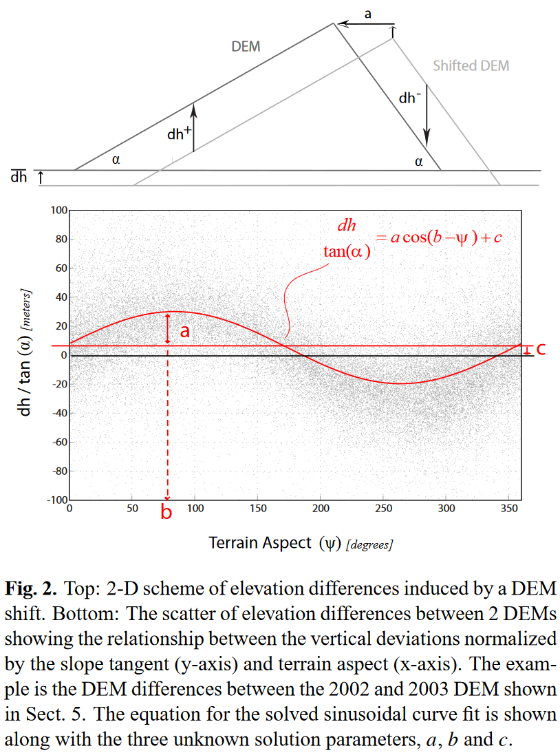
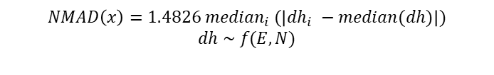
Method ‘CBD’| Results and Discussion | Conclusion and Outlooks
Co-registration: the step to produce the real differences
(a) NuthKaab Co-registration (2011)
(b) Gradient Descent Co-registration
$$NMAD\left(x\right)=1.4826 {median}_{i} (\left|{dh}_{i} −median(dh)\right|)$$
$$dh \sim f(E, N)$$
Image from https://opentopography.org/blog/interpreting-errors-topographic-differencing-results
Nuth, C., & Kääb, A. (2011). Co-registration and bias corrections of satellite elevation data sets for quantifying glacier thickness change. The Cryosphere, 5(1), 271–290. https://doi.org/10.5194/tc-5-271-2011
Notes:
The NuthKaab co-registration method solves co-registration issue by identifying the statistic patterns of elevation differences that are related to slope and aspect. The relationship has been described by this 2-dimensional curve line. Here, when the DEM is correctly shifted back, the curve of elevation difference is going to be straight. But this solution requires calculated the slope and aspect, if the research area is entire Norway, and if the DEM is in 1 m resolution. The calculation is going to be extensive.
So, this study created a co-registration algorithm, called Gradient Descent co-registration. It describes the elevation difference in a 3-dimensional curved surface; it aims to find the shift matrix using gradient descent algorithm, resulting in the local minimal of NMAD.

Slide 12
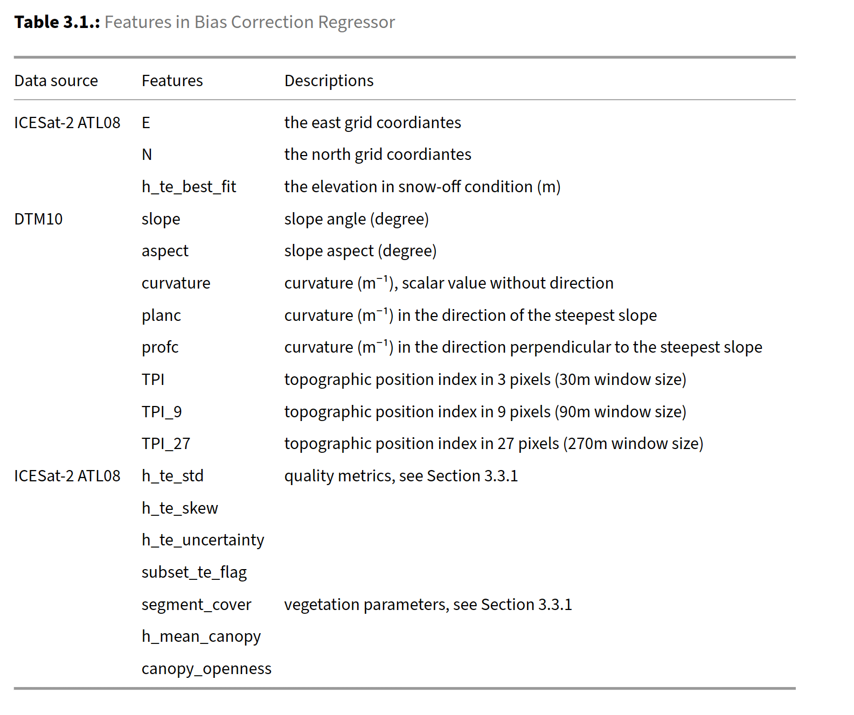
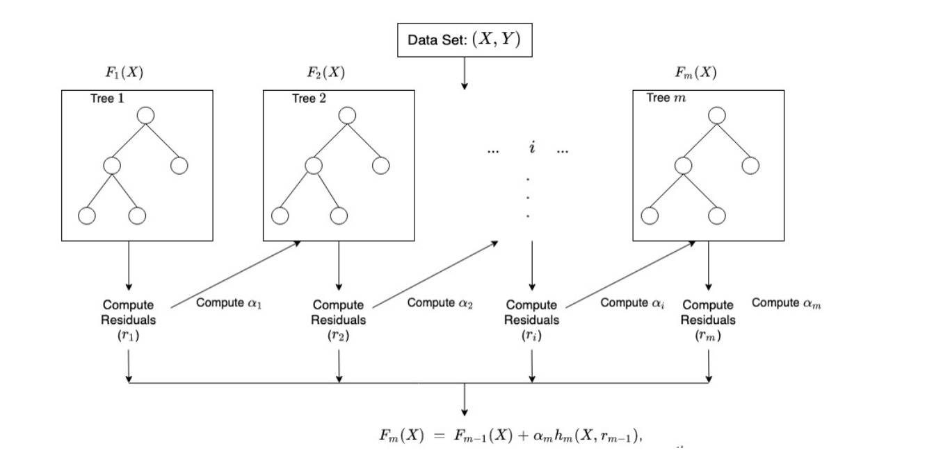
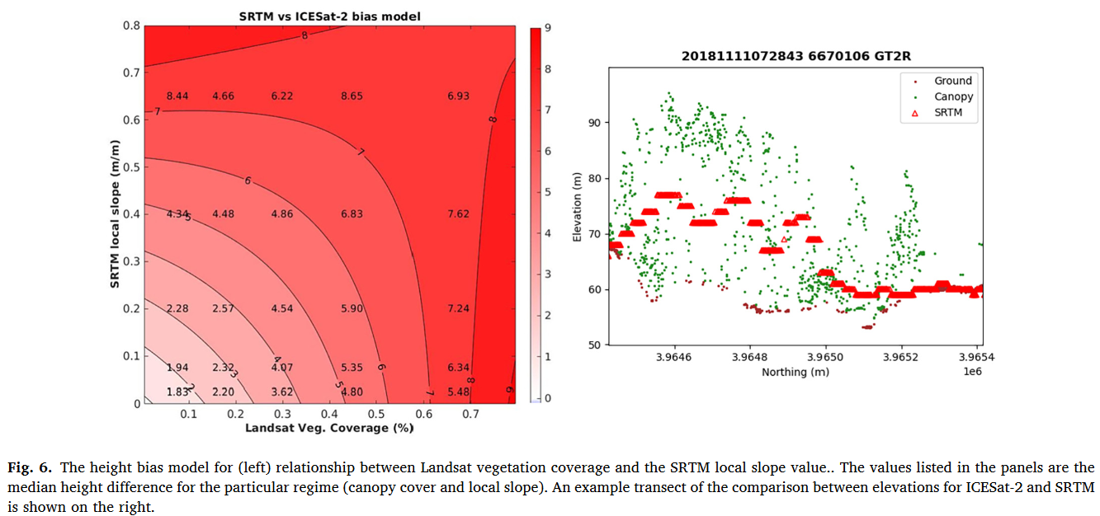
Method ‘CBD’| Results and Discussion | Conclusion and Outlooks
Bias correction
Using ICESat-2 snow free measurements to correct DEM (Magruder et al., 2021)
XGBoost model structure
Magruder, L., Neuenschwander, A., & Klotz, B. (2021). Digital terrain model elevation corrections using space-based imagery and ICESat-2 laser altimetry. Remote Sensing of Environment, 264, 112621.
Notes:
Bias are widespread in DEMs. Since the ICESat-2 also provide the snow-free segments. Is that possible to use ICESat-2 to correct the bias of DEM?
One of research proposes a two-dimensional bias correction method for SRTM using elevation from ICESat-2 ATL08 product, leading to enhanced accuracy of DEM. This correction is based on slope and vegetation coverage. However, the bias can vary across multiple dimensions.
Therefore, this study employs a regression model by XGBoost to predict the bias, using various features such as terrain parameters, vegetation, and quality metrics from ICESat-2.
The bias corrected DEM and ICESat-2 snow on measurements can be used to produce the snow depth.

Slide 13


Method ‘CBD’| Results and Discussion | Conclusion and Outlooks
Downscaling: A technique using historical experience to enrich the input
+ details by AI
150 × 211
Original
3000 × 4220
AI Generated
AI can up-sample the face, according to the training of million samples.
The distribution patterns of snow cover exhibit a notable resemblance year after year due to their dependence on topography, vegetation, and consistent synoptic weather patterns (Sturm & Wagner, 2010; Trujillo et al., 2007). And the subgrid variability can also be inferred, so called downscaling.
What is downscaling?
Bernd’s profile https://www.mn.uio.no/geo/english/people/aca/geohyd/bernde/
Photo up-sampling tool: https://huggingface.co/spaces/Xintao/GFPGAN
Sturm, M., & Wagner, A. M. (2010). Using repeated patterns in snow distribution modeling: An Arctic example. Water Resources Research, 46(12)
Notes:
What is the downscaling?
This is Bernd’s profile picture, I choose it because this is in low-resolution; it has only 150 by 211 pixels. With the development of AI, which has been training by million human faces, so AI is able to restore the details according to the experience from training.
This is called downscaling in climate science.
There are so many studies imply there is a repeated pattern of snow depth distribution, so is it possible to do it by machine learning?

Slide 14
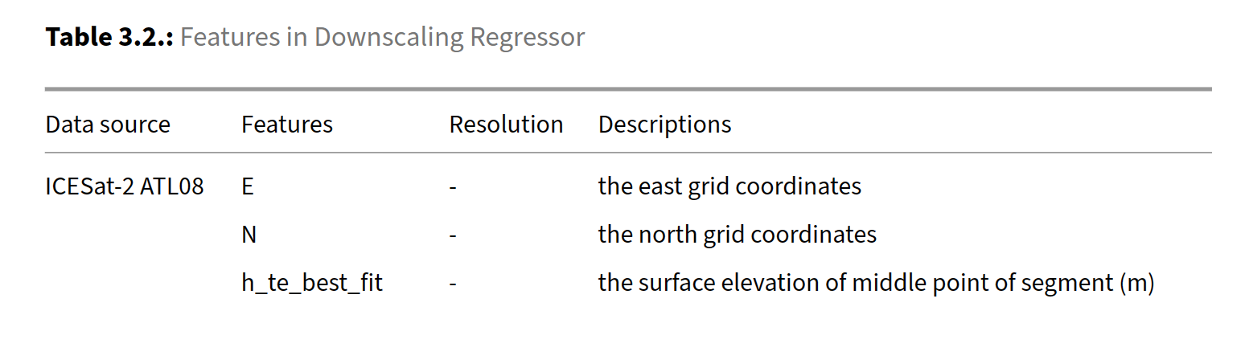

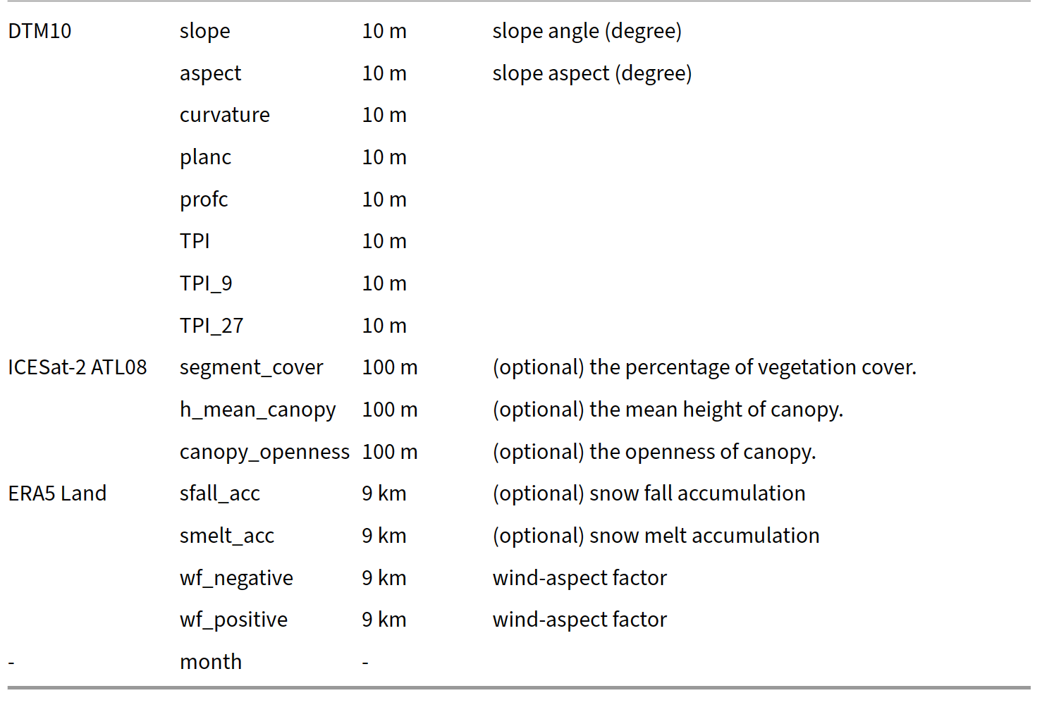
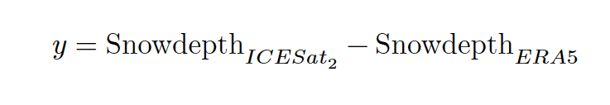
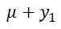
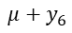
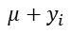
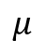
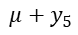
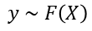
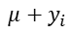
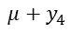
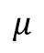
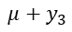
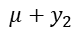
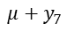
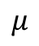
Method ‘CBD’| Results and Discussion | Conclusion and Outlooks
Downscaling: How it works
Snow depth
ERA5 Land (9km)
$$y \sim F\left(X\right)$$
Snow depth
Sub-grid distribution
$$μ+y_{1}$$
$$μ+y_{2}$$
$$μ+y_{3}$$
$$μ$$
$$μ+y_{4}$$
$$μ+y_{5}$$
$$μ+y_{6}$$
$$μ+y_{7}$$
$$…$$
$$μ+y_{i}$$
$$μ$$
$$μ$$
De-trend
Downscaling (inflation regression)
The predictor features are chosen and pre-pressed to explain the local variability of snow distribution.
Re-trend
Delta change method (Rosenzweig 1985)
- Stationary assumptions.
- Explainable predictors. If the variance can not be explained by predictors, then the variability will not be described by regression.
$$μ+y_{i}$$
Notes:
Yes.
First, I have snow depth input from ERA5 Land, which is the mean snow depth representing a grid of 9 km. And this transfer function should be able to reproduce the deviation of local snow depth relative to the mean value. So that we got the downscaled snow depth.
To do this, this transfer regressor is trained by
The difference of snow depth from ICESat-2 and snow depth from ERA
Then, the feature in this table are used in regression
In the end, we get the snow depth by sum up the predicted value and snow depth from ERA

Slide 15
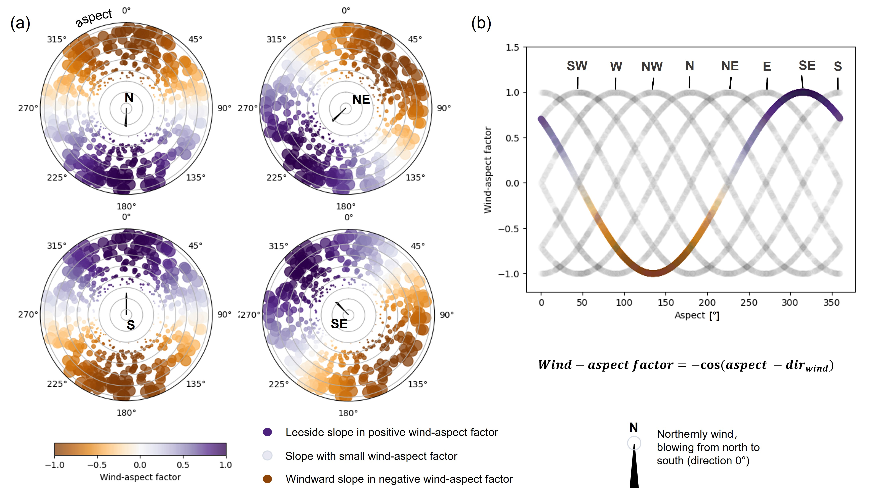
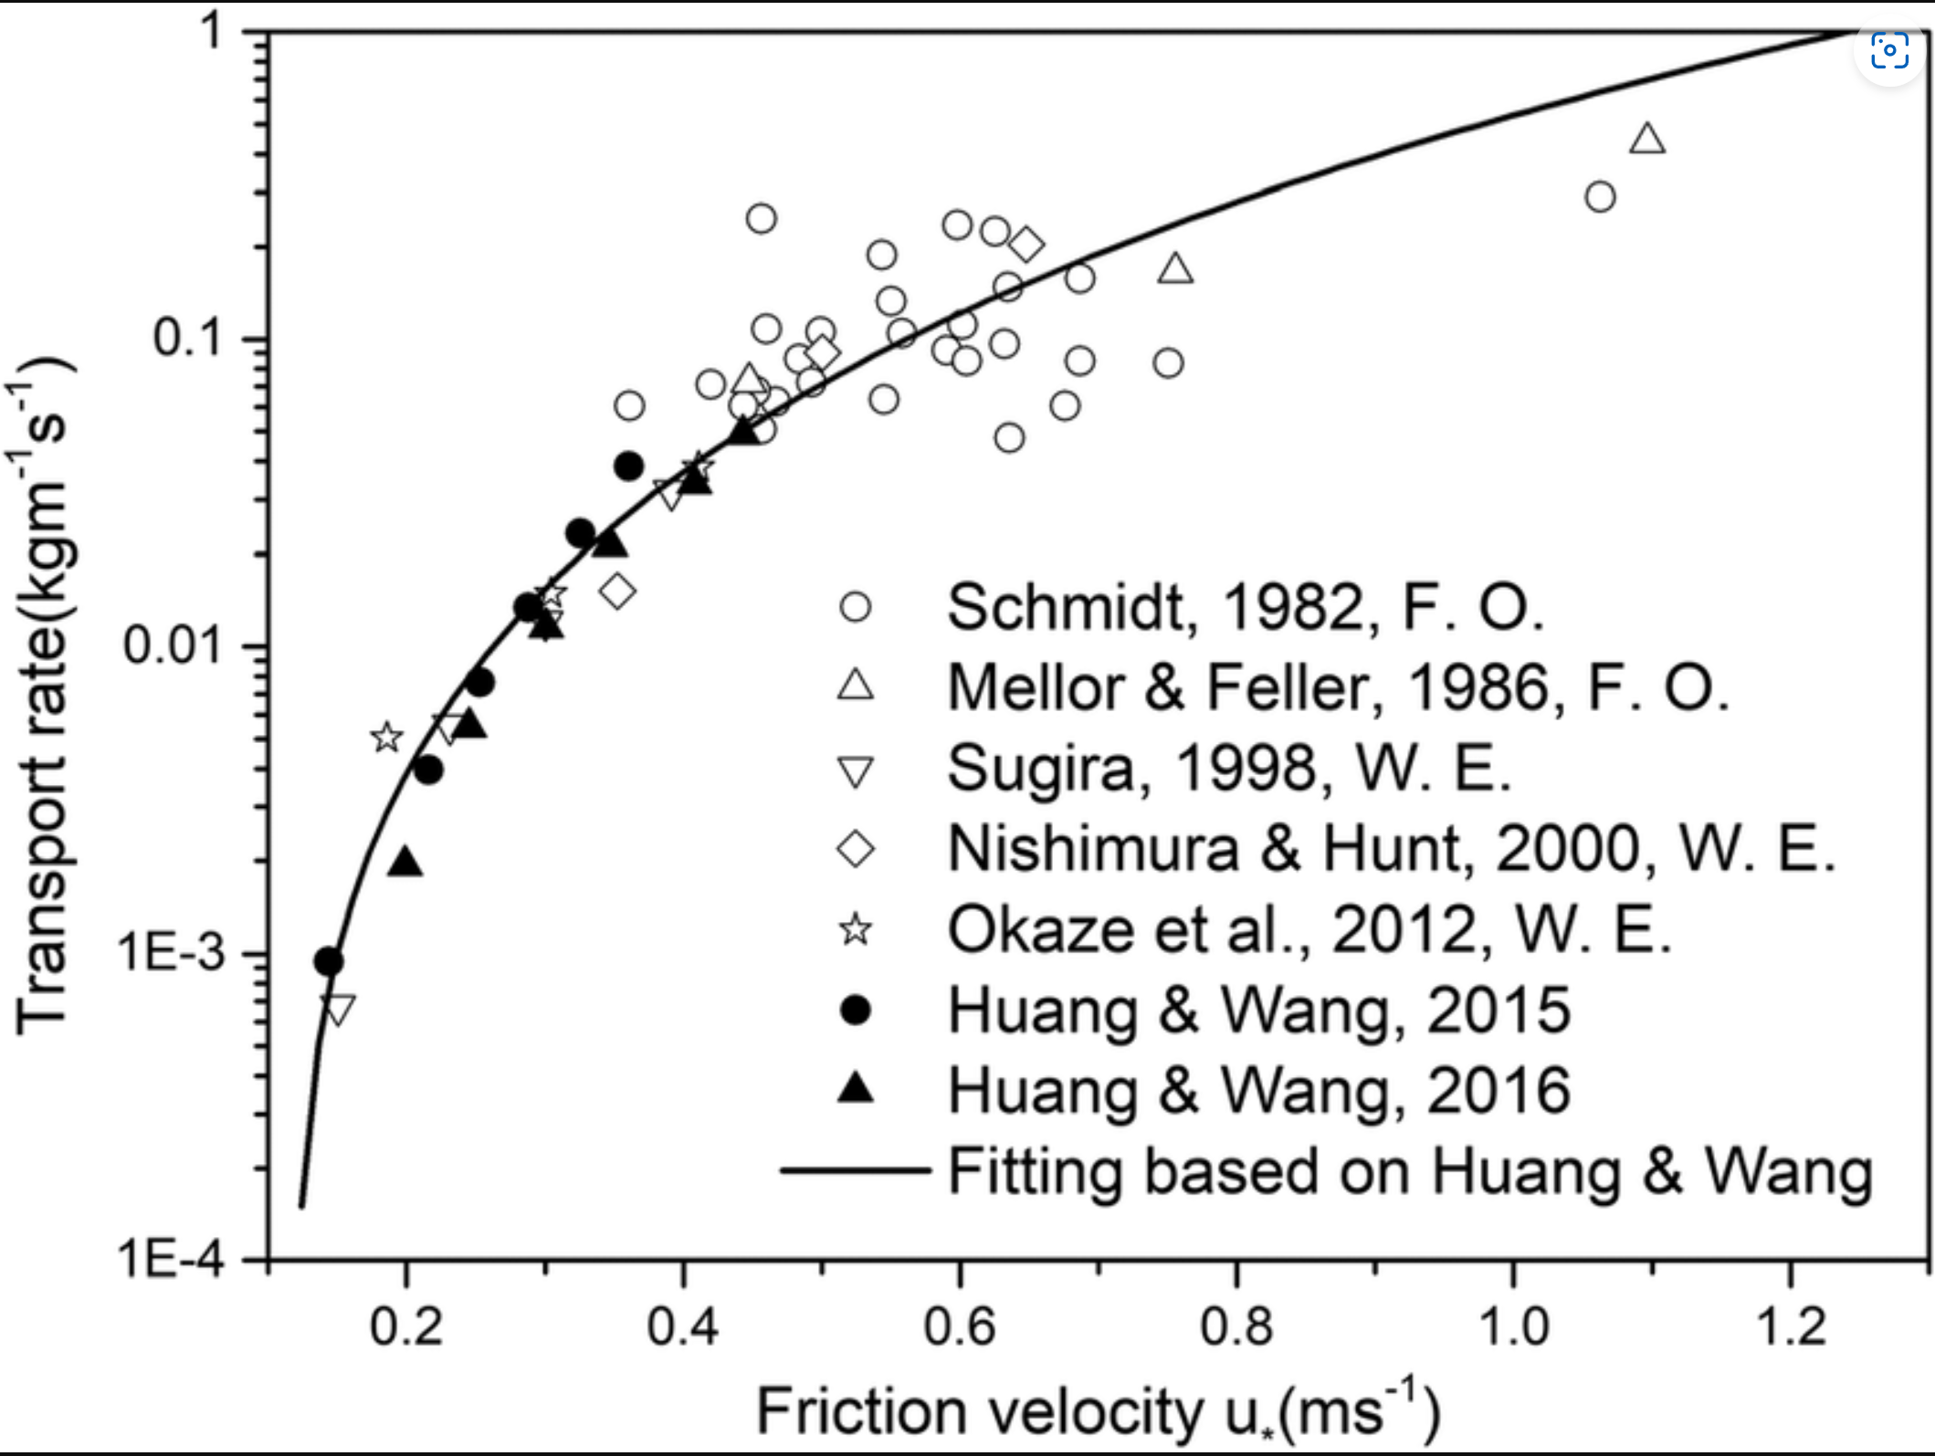
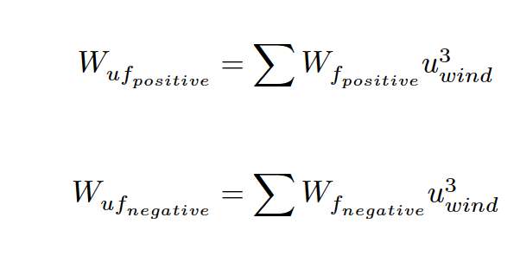
Method ‘CBD’| Results and Discussion | Conclusion and Outlooks
Downscaling: wind-aspect factor
*Only accumulate when snow depth (ERA5) > 0.1 m

Slide 16
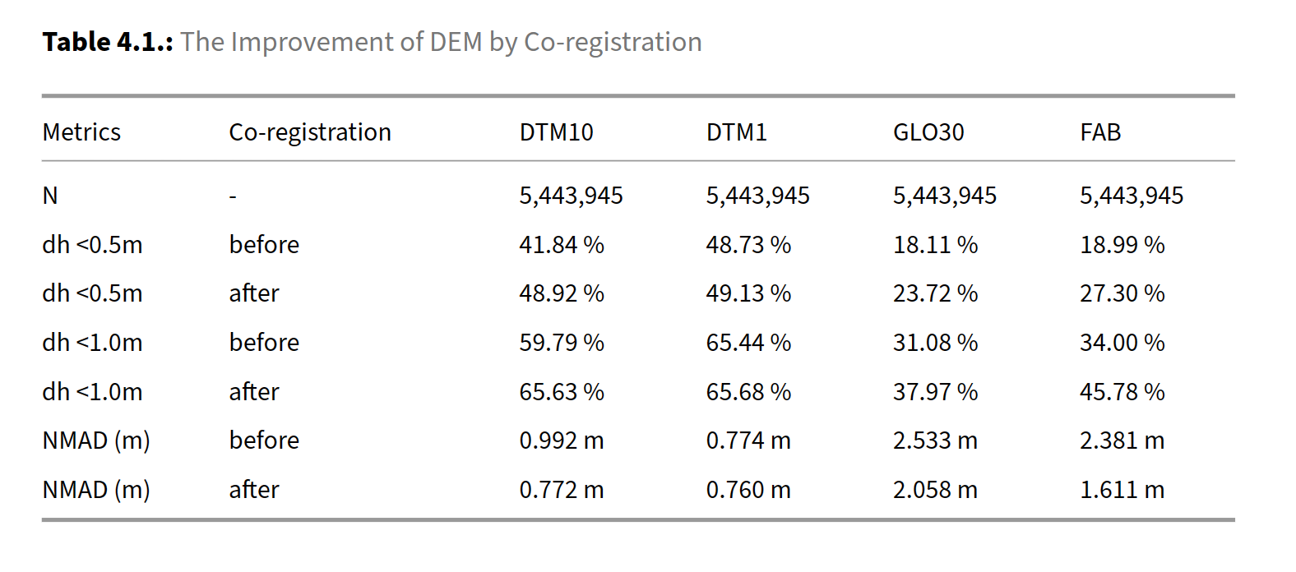
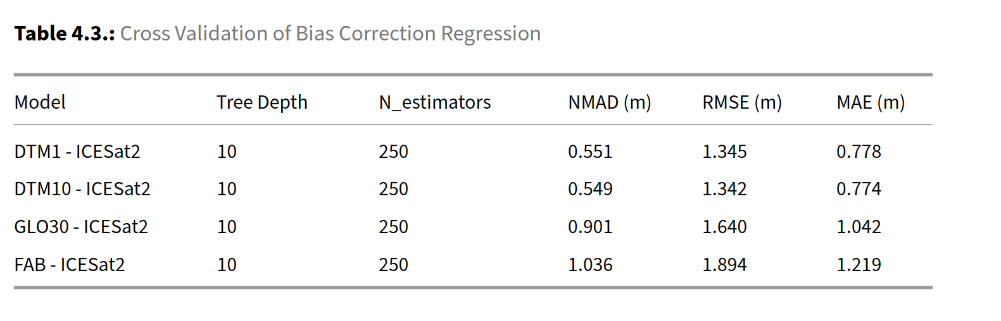
Results and Discussion | Conclusion and Outlooks
Co-registration and bias correction improved the DEM quality
Photo up-sampling tool:: https://huggingface.co/spaces/Xintao/GFPGAN
Notes:
The NMAD shows a 2% improvement for DTM1, while DTM10, GLO30, and FAB exhibit an improvement of 22%, 21%, and 35%, respectively. Subsequently, after co‑registration, the percentage of points with a deviation less than 0.5 m from ICESat‑2 snow‑free segments is calculated to be 48.9%, 49.13%, 23.7%, and 27.2% for DTM1, DTM10, GLO30, and FAB, respectively.
If using ICESat-2 snow free segments as reference to correct DEMs, the corrected residual errors have approximate 0.55 m for DTM1 and DTM10, 0.9 m and 1.0 m for Copernicus GLO30 and FABDEM. This is the overall discrepancy, if we look into in statistical bins.

Slide 17
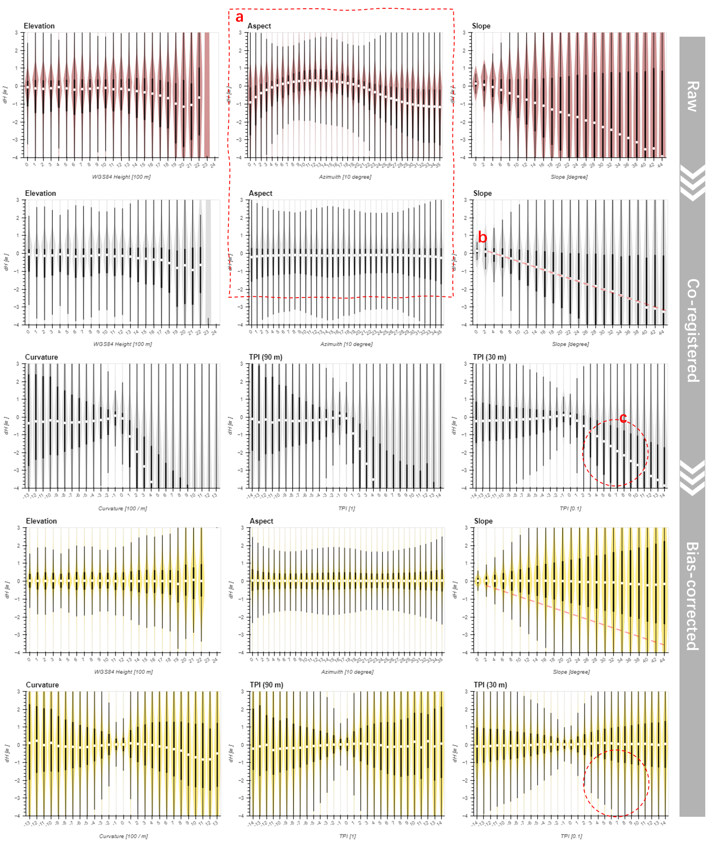
Results and Discussion | Conclusion and Outlooks
ICESat-2 ATL08’s negative skewness is related to curvature
The co-registration removed the aspect-dependent error. However, the 25% quantile (Q1) and the 75% quartile (Q3) are still skewed negative.
Significant negative bias has been identified for large slopes over four DEMs. (Enderlin et al., 2022, Magruder et al., 2021, Tian & Shan, 2021, Moudrý et al., 2022)
The same bias does exist over convex terrain but is not significant over concave terrain, indicated by TPI and curvature bins.
And the bias correction can remove these bias patterns.
Enderlin, et al. (2022). Uncertainty of ICESat-2 ATL06- and ATL08-derived snow depths for glacierized and vegetated mountain regions. Remote Sensing of Environment
Magruder, et al. (2021). Digital terrain model elevation corrections using space-based imagery and ICESat-2 laser altimetry. Remote Sensing of Environment,
Tian, X., & Shan, J. (2021). Comprehensive Evaluation of the ICESat-2 ATL08 Terrain Product. IEEE Transactions on Geoscience and Remote Sensing, 59(10), 8195–8209.
Notes:
In Figure @fig:binning a, the aspect-dependent error, or the fingerprint of misalignment, is depicted and removed through co-registration, where the median value (Q2) is located close to zero for all bins. However, the 25% quantile (Q1) and the 75% quartile (Q3) are still skewed negative (i.e., Q3-Q2 < Q2-Q1) . Significant negative bias has been identified for large slopes (Figure @fig:binning b) as there exists a nearly linear relationship between median and slope. Some studies have applied vertical bias correction based on slope [@enderlin.etal_2022], slope and vegetation [@magruder.etal_2021], or laser incidence angles and vegetation [@tian.shan_2021]. However, this study shows that the bias does exist over convex terrain but is not significant over concave terrain, indicated by TPI and curvature bins (Figure @fig:binning c).
And the bias correction can remove these bias patterns.

Slide 18
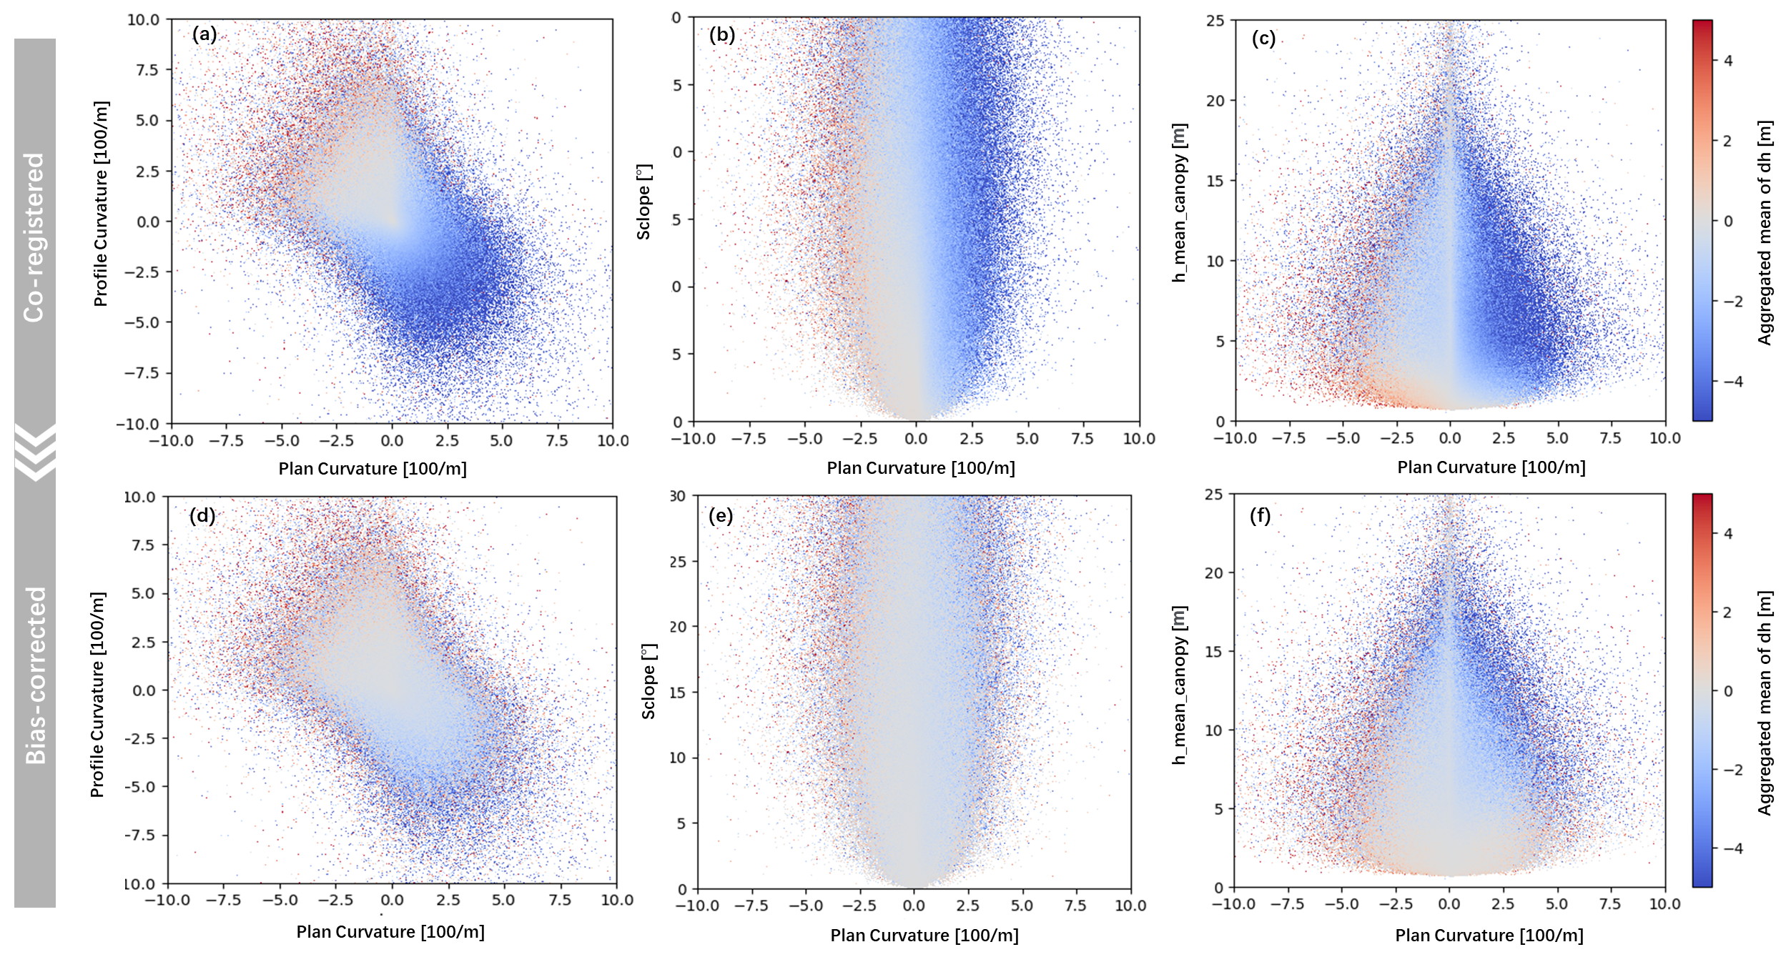
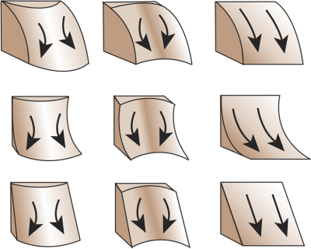
Results and Discussion | Conclusion and Outlooks
ICESat-2 ATL08’s negative skewness is related to curvature
Figure 5.1.: Skewness Variations in Convex and Concave Terrains. The elevation difference is between ICESat‑2 snow free segments and DTM1.
Notes:
To further investigating the negative skewness, Figure 5.1 plots nine curvature combinations catego‑ rized by profile curvature and plan curvature. The aggregated mean value of elevation differences reveals that convex ridged terrain (positive plan curvature and negative profile curvature) typically exhibits the negative skewness (Figure 5.1 a,g). A concave bowl‑shaped terrain with negative profile curvature does not have much negative skewness, even at high slopes (Figure 5.1 b), thereby indicat‑ ing that the observed linear relationship between bias and slope (Figure 4.2 b) is mainly contributed by plan curvature. Moreover, the canopy height contributes significantly to positive bias when the canopy is short upon concave terrain, but it cannot equalize for all the observed negative skewness (Figure 5.1 c). Therefore, it can be inferred that plan curvature plays a significant role in influencing skewness. Based on these findings, this study does not recommend any bias correction based solely on slope and/or canopy height. Instead, the bias correction method used in this study can remove the negative skewness over different features (Figure 5.1 d,e,f)

Slide 19
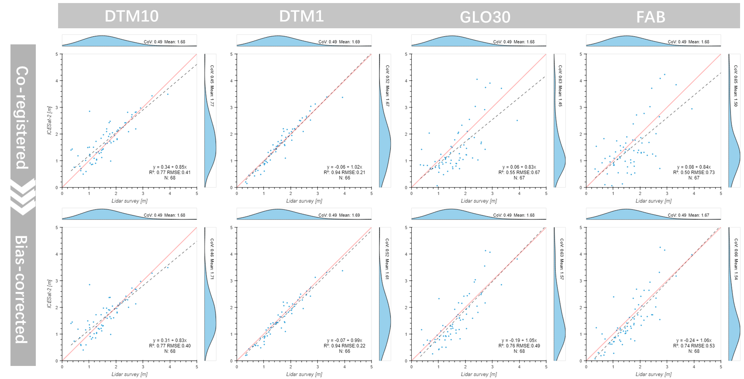
Results and Discussion | Conclusion and Outlooks
The ICESat2‑DTM1 derived snow depth showed excellent correlation (R‑Squared 0.94) to validation
67
Figure 4.8.: The Validation of ICESat‑2 Derived Snow Depth.
Notes:
The ICESat2‑DTM1 derived snow depth showed excellent correlation (R‑Squared 0.94) with lidar‑based snow depth validation from Spring 2022 (67 points).
In Hardangervidda, the drone trip on 11th March 2022 corresponded 68 valid snow-on-surface measurements to the ATL08 segments on 5th March 2022. Figure @fig:lidar_validation shows a scatter plot indicating a very good agreement, where the ICESat-2 - DTM1 model has an R-Squared of 0.94 and RMSE of 0.22 m. It is important to note that the validation snow depth is calculated based on DTM1 as reference ground, so that the DTM10 (has a resolution of 10-meters) got an R-Squared value of 0.77 with an RMSE of 0.40 m. On the other hand, global DEMs such as GLO30 and FAB achieve good fitness after applying bias correction, with R-Squared values of 0.76 and 0.74 and RMSEs of 0.49 m and 0.53 m, respectively.

Slide 20
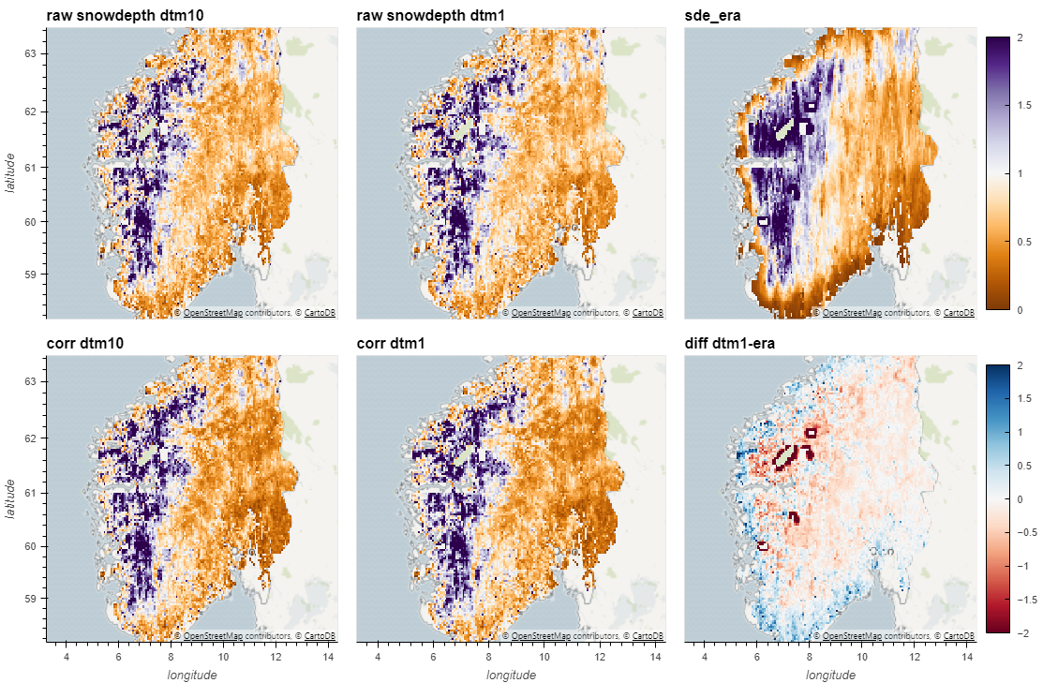



Results and Discussion | Conclusion and Outlooks
The ICESat2 derived snow depth vs ERA5 Land
DTM10
DTM1
DTM1 – ERA5 Land
ICESat-2 derived snow depth
5 million snow-on segments 2018-2022
aggregation
Vs.
ERA5 Land
spatial-temporal coupled
aggregation
Differences [m]
GLO30
FAB
ERA5 Land
Snow depth [m]
DTM10
DTM1
DTM1 – ERA5 Land
Differences [m]
GLO30
FAB
ERA5 Land
Snow depth [m]

Slide 21

Results and Discussion | Conclusion and Outlooks
Downscaled snow depth
7127
Figure 4.12.: The Validation of Snow Depth Downscaling: Plan Curvature, Vegetation Coverage, Elevation and East.

Slide 22

Results and Discussion | Conclusion and Outlooks
Downscaled snow depth has Spearman correlation 0.81 and R-Squared 0.68, and needs bias adjustment
Figure 4.11.: The Validation of Snow Depth Downscaling: Histogram and Scattering.
Notes:
the prediction of the local variable in general has lower variance than the observed local variable.

Slide 23

Results and Discussion | Conclusion and Outlooks
Downscaled snow depth vs validation
The validation area:
Strong wind, many small depressions as wind shelter, resulting in high variability of snow depth, and repeated patterns.
The results:
Four DEMs show negligible differences.
Local model has a higher Spearman correlation to the global model.
Figure 4.10.: The Validation of Snow Depth Downscaling (2008.04)
Notes:
The snow depth from ERA5 Land that needs to be downscaled shows no variability at this scale (a). The NVE’s ALS snow surveyconducted in April 2008 provided validation strip, which is located in the northwest of the survey area. (d) and show significant variations across depressions and hilltops. The same strip is also displayed in Melvold & Skaugen (2013)’s Figure 3 (b). The downscaled snow depth from the ICESat 2 ‑ DTM1 model reproduced most of the variability (c). Moreover, there were differences between the model and validation, which are shown in (e), while the profile difference is visible in (f). The depressions are numbered 1 to 14, from west to east. Note: The validated snow depth is at a resolution of 2 meters and excludes the water surface, where values are zero. The model is trained in a region that is 100 kmwider the validation area in all directions. The downscaling model output has a resolution of 10 meters and includes water surfaces where values may not be reliable.

Slide 24

Results and Discussion | Conclusion and Outlooks
Downscaled snow depth vs validation
Figure A.3.: The Validation of Snow Depth Downscaling (2009.04)

Slide 25



Conclusion and Outlooks
Our results are able to reproduce snow depth patterns at the hill-slope scale, achieving an R-Squared value of 0.68 and a Spearman correlation coefficient of 0.81 when compared to lidar-based snow depth acquired in Hardangervidda, Norway.
Further work on downscaling
More validation
Feature engineering
Randomization (Maraun 2013)
Potential applications
Hydrological models (Freudiger 2017)
Permafrost Mapping (Gisnas et,al. 2016)
Avalanche assessment
Gisnås, K., Westermann, S., Schuler, T. V., Melvold, K., & Etzelmüller, B. (2016). Small-scale variation of snow in a regional permafrost model. The Cryosphere
Freudiger, D., Kohn, I., Seibert, J., Stahl, K., & Weiler, M. (2017). Snow redistribution for the hydrological modeling of alpine catchments. Wiley Interdisciplinary Reviews: Water, 4(5), e1232
Maraun, D. (2013). Bias Correction, Quantile Mapping, and Downscaling: Revisiting the Inflation Issue. Journal of Climate, 26(6), 2137–2143. https://doi.org/10.1175/JCLI-D-12-00821.1

Slide 26
Conclusion and Outlooks
Our results are able to reproduce snow depth patterns at the hill-slope scale, achieving an R-Squared value of 0.68 and a Spearman correlation coefficient of 0.81 when compared to lidar-based snow depth acquired in Hardangervidda, Norway.
This approach is applicable globally in any location where accurate snow-free DEMs are available. Additionally, this study contributes a Gradient Descent Co-registration algorithm, which offers possibilities for handling large-scale datasets at a fine resolution. And, a bias correction workflow is utilized to address uncertainties of DEM and ICESat-2, which refines the conventional elevation differencing workflow of producing snow depth.
Further work on elevation differencing workflow
Extend study area
Refine bias correction over vegetated area
Potential applications
- Using ICESat-2 co-registering DEMs

Slide 27
Conclusion and Outlooks
Our results are able to reproduce snow depth patterns at the hill-slope scale, achieving an R-Squared value of 0.68 and a Spearman correlation coefficient of 0.81 when compared to lidar-based snow depth acquired in Hardangervidda, Norway.
This approach is applicable globally in any location where accurate snow-free DEMs are available. Additionally, this study contributes a Gradient Descent Co-registration algorithm, which offers possibilities for handling large-scale datasets at a fine resolution. And, a bias correction workflow is utilized to address uncertainties of DEM and ICESat-2, which refines the conventional elevation differencing workflow of producing snow depth.
The negative skewness of ICESat‑2 ATL08 has been observed in many studies. This study high‑lights the critical role played by curvature and vegetation, which is more important than slope and atmospheric scattering. The bias correction proposed in this study can resolve this issue.
Potential applications
- All ICESat-2 ATL08 studies

Slide 28


Statement of solutions: Modeling

Slide 29
Hyperparameters and cross‑validation
Photo up-sampling tool:: https://huggingface.co/spaces/Xintao/GFPGAN

